Slide 1
TutorialHub
AI Powered Course Generator
Team Members:
Jyoti (2127970) (Authentication & Payment Gateway)
Prashant Sagar Shakya (2127984) (Backend Developer)
Sonu (2127992) (Frontend Developer)
Computer Science and Engineering
I.K. Gujral Punjab Technical University Mohali Campus 1

Slide 2
Introduction

Slide 3
TutorialHub is an innovative, AI-driven platform designed to revolutionize course creation and learning.
Instant Course Generation: Transforms a single topic input into a complete educational course using Google's Gemini AI.
Rich Content: Automatically creates structured chapter outlines, detailed chapter content, relevant YouTube video integrations, and interactive quizzes.
AI Assistance: Features a real-time "Ask TutHub AI" chat for user queries and learning support, powered by Gemini.
Secure & Modern: Built with Next.js 14, TypeScript, Drizzle ORM, NeonDB (PostgreSQL), and secure user authentication via Clerk.
Personalized & Accessible: Offers a responsive interface with light/dark modes, enabling users to create and consume high-quality educational content effortlessly.

Slide 4
Problem Statement

Slide 5
Creating comprehensive and engaging educational courses traditionally involves significant time, effort, and expertise. Educators and content creators often face challenges such as:
Time-Consuming Content Development: Researching, structuring, writing, and finding relevant media is a lengthy process.
Technical Barriers: Integrating various learning elements (videos, quizzes) can be complex.
Maintaining Engagement: Crafting interactive and diverse learning materials is crucial but difficult.
Scalability: Quickly producing multiple courses or updating existing ones is a major hurdle.
TutorialHub aims to solve these problems by automating and simplifying the course creation lifecycle.

Slide 6

Objectives

Slide 7
Automate Course Creation: Develop a platform where users can generate full-fledged courses from minimal input using AI.
Enhance Learning Experience: Integrate diverse learning materials like text, videos, and interactive quizzes automatically.
Provide AI-Powered Support: Implement an AI chat assistant for real-time learner and creator support.
Ensure Security & Scalability: Implement robust user authentication (Clerk) and a scalable architecture.
Facilitate Monetization: Integrate a payment gateway (Razorpay) for premium features and subscription plans.
User-Friendly Interface: Design an intuitive and responsive UI for seamless course creation and consumption.

Slide 8

Methodology

Slide 9
AI Core: Google's Gemini API for generating course outlines, chapter content, and quizzes.
Dynamic Content Integration: Automated fetching of relevant YouTube videos and topic-based banner images.
Interactive Learning: AI-generated quizzes for assessment and an AI chat for on-demand assistance.
Modern Tech Stack for Robustness & UX:
Next.js 14 (App Router) & TypeScript: For a type-safe, high-performance full-stack application.
Drizzle ORM & NeonDB (PostgreSQL): For efficient and scalable data management.
Clerk Authentication: For secure user sign-up, sign-in, and profile management.
Razorpay: For secure and seamless payment processing for subscription plans.
Tailwind CSS & Shadcn UI: For a modern, responsive, and customizable user interface.

Slide 10
Tools & Technology Used
MERN: Web Framework
ADAPTABILITY
AI Engine: Gemini 2.5 Pro
Drizzle(Postgres): Database ORM
RazorPay: Payment Integration
Clerk: User Authentication

Slide 11
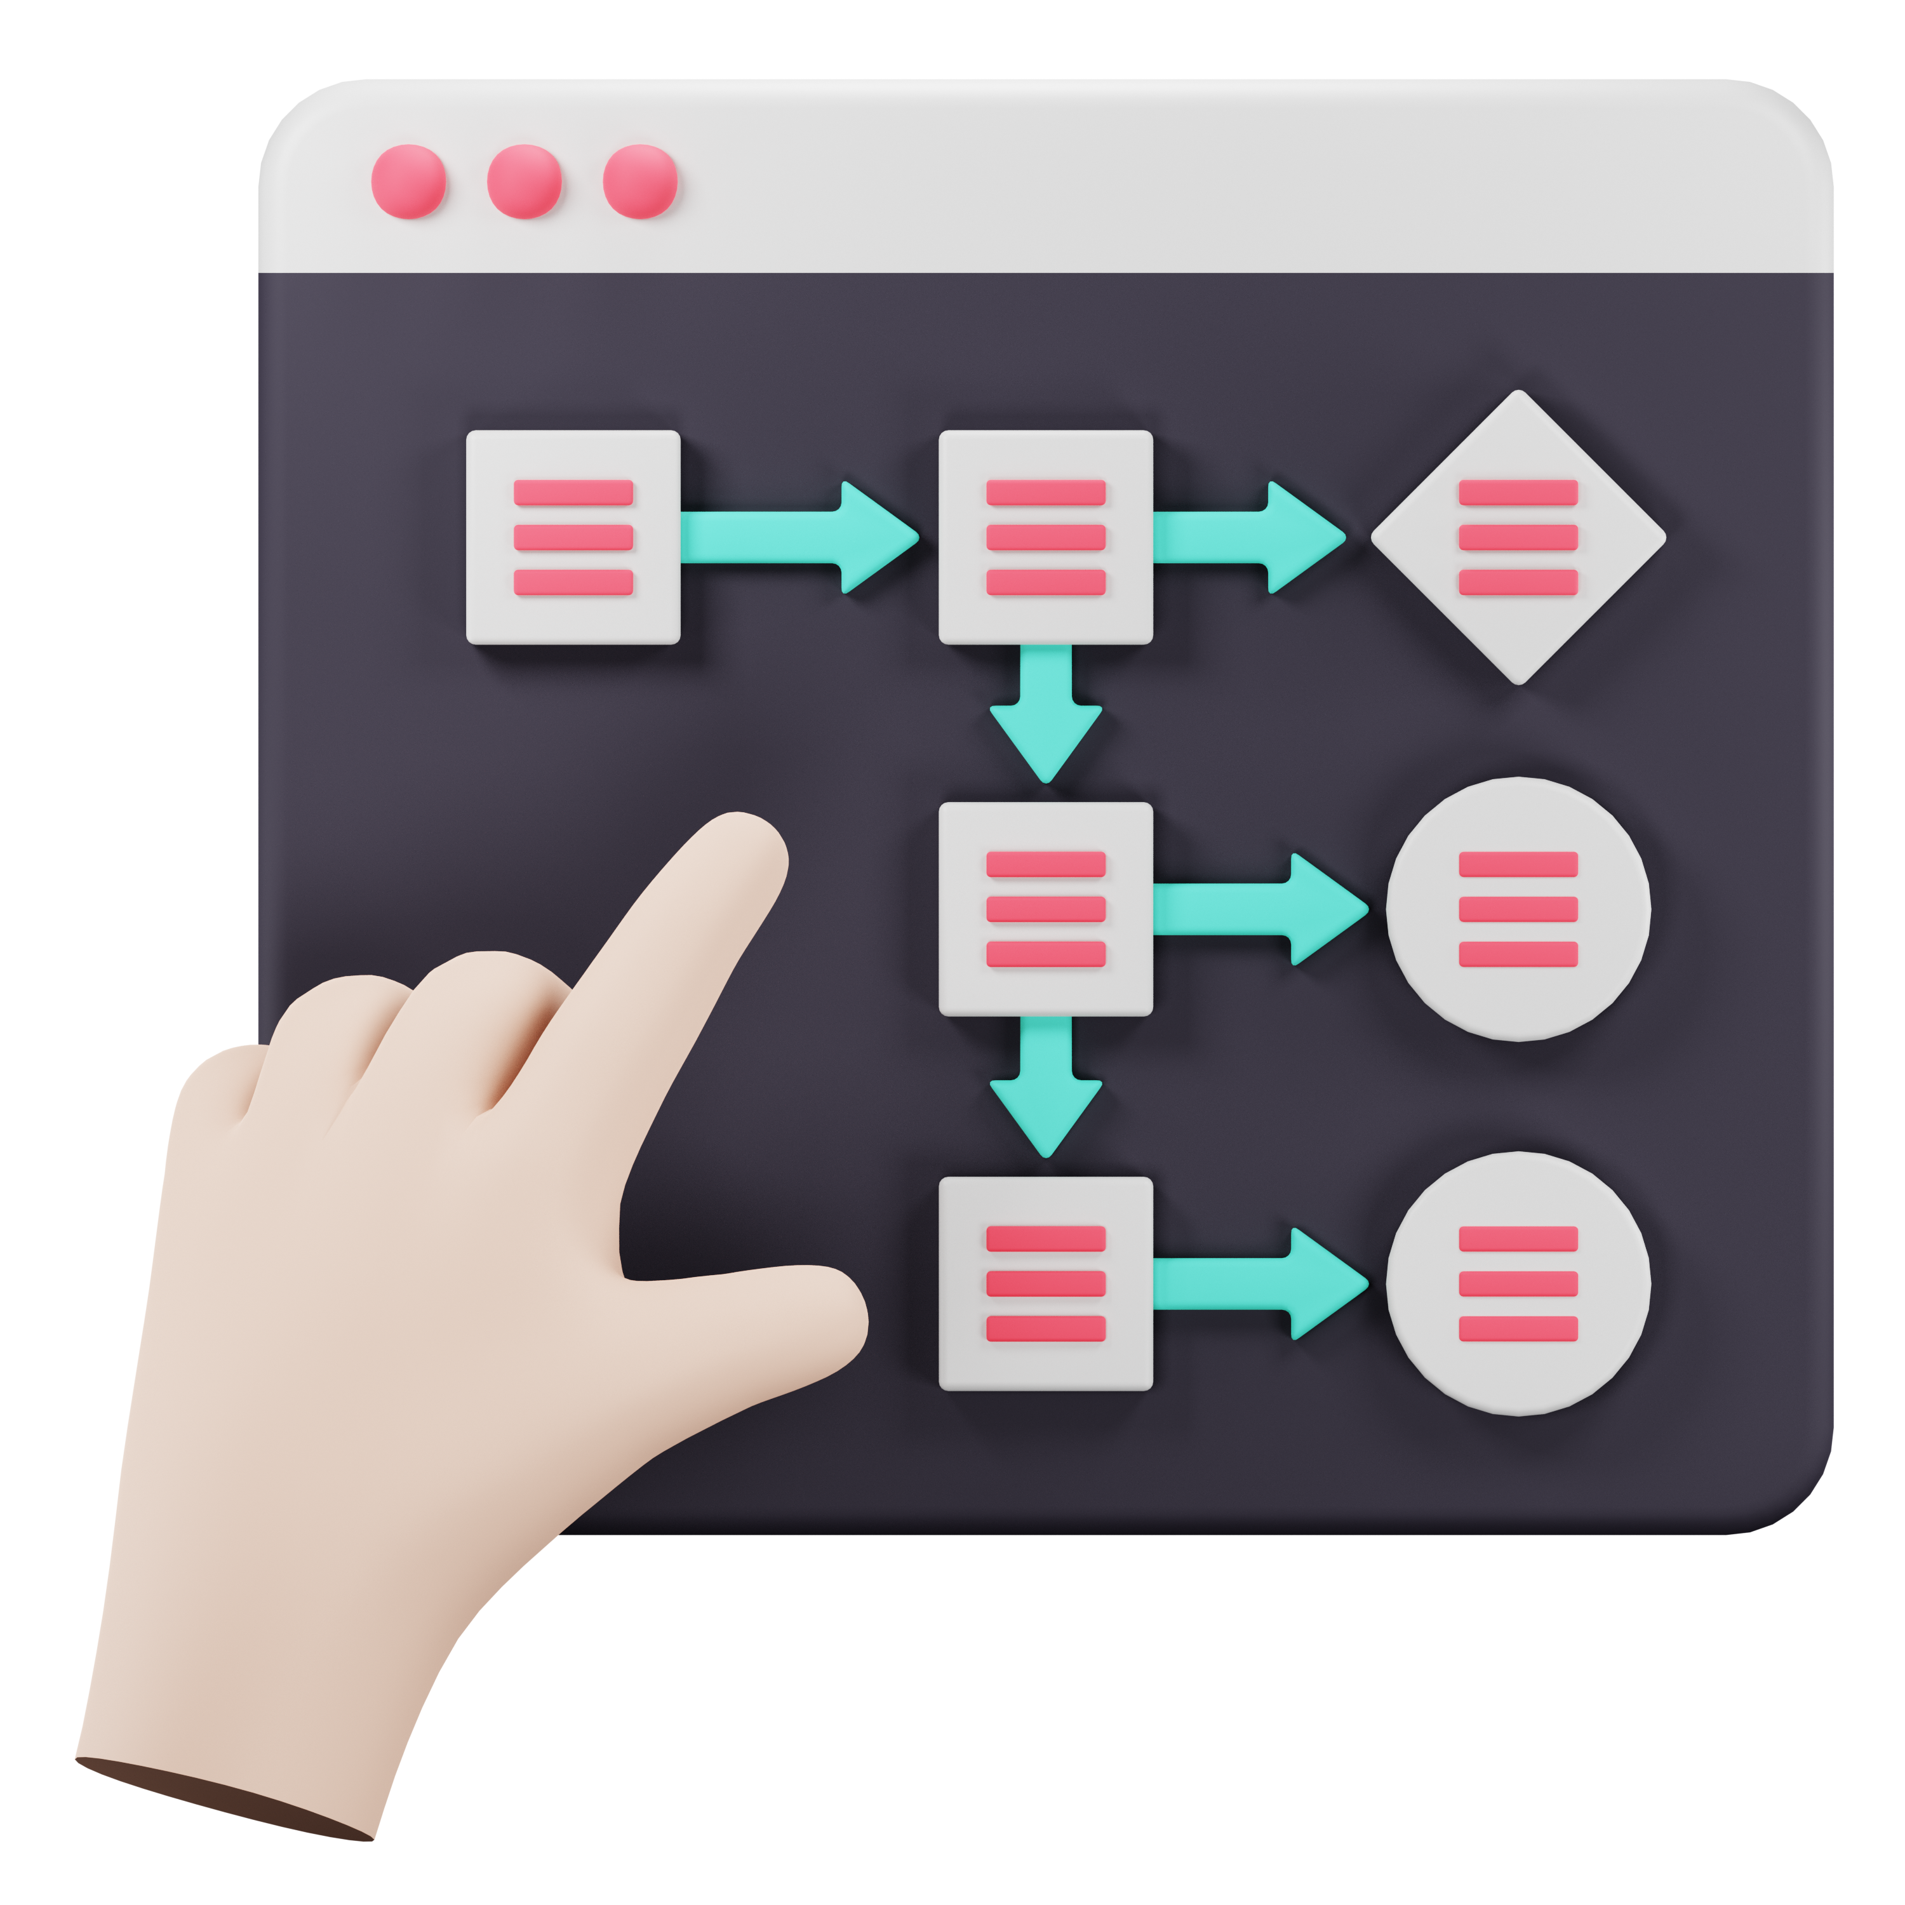
Design and Implementation Details

Slide 12
The design of TutorialHub involves a modular architecture that separates concerns between the frontend, backend, and database. Data flow diagrams and ER diagrams are used to model the relationships and interactions between different components of the system.

Slide 13
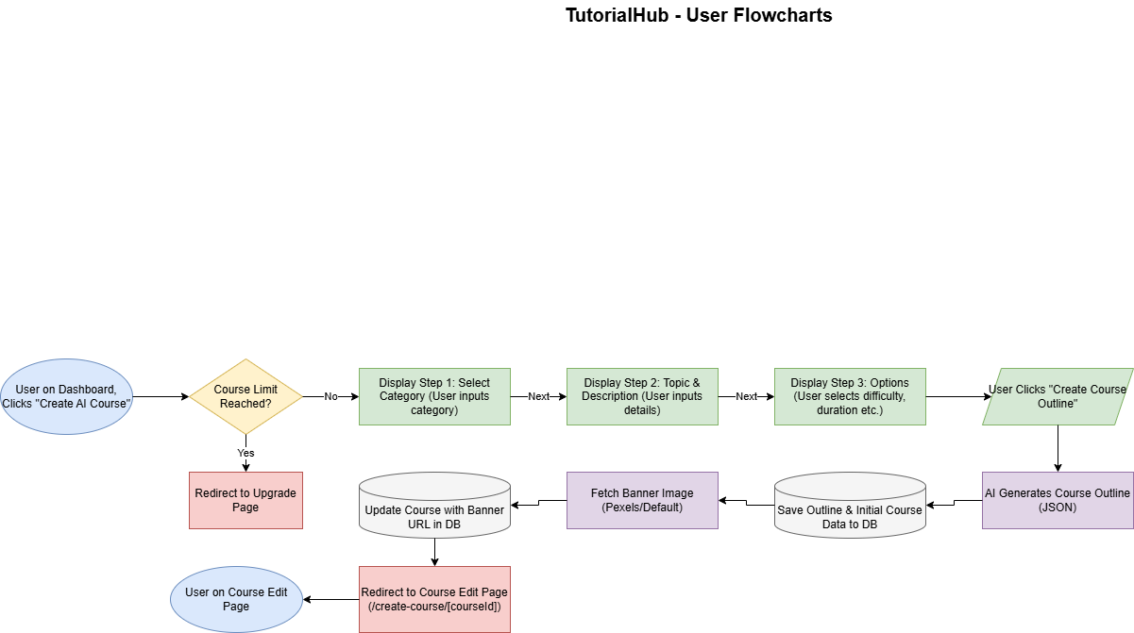
Flow Chart

Slide 16
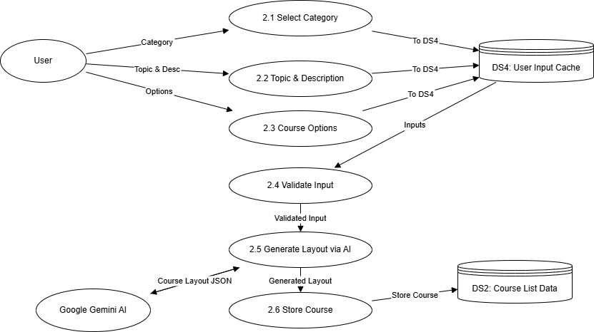
Data Flow Diagram

Slide 17
PROJECT STAGES
STEP 2
STEP 1
STEP 3
Content Generation and UI
Foundation and Core AI Logic
Advanced Features & Monetization

Slide 18
Objective Achieved
Secure, Clerk-based Authentication
AI-powered Course Generator with Gemini
Real-time Tutor Chat Interface
Offer user-customizable content
Auto-generated Quizzes per Chapter
Track user progress and quiz scores
Provide seamless access via secure login.
Enable monetization through paid tiers.

Slide 19
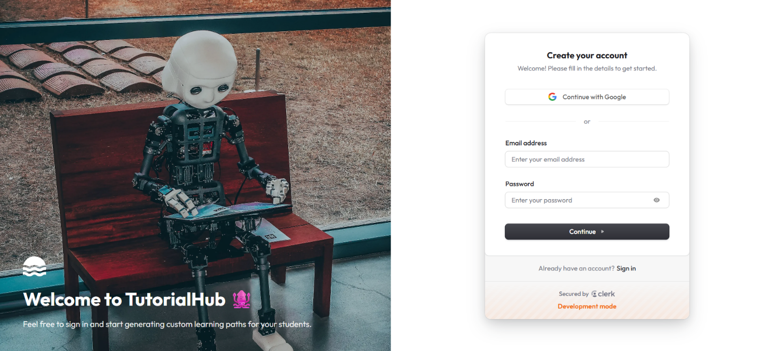
Step 1. Homepage with Clerk Authentication

Slide 20
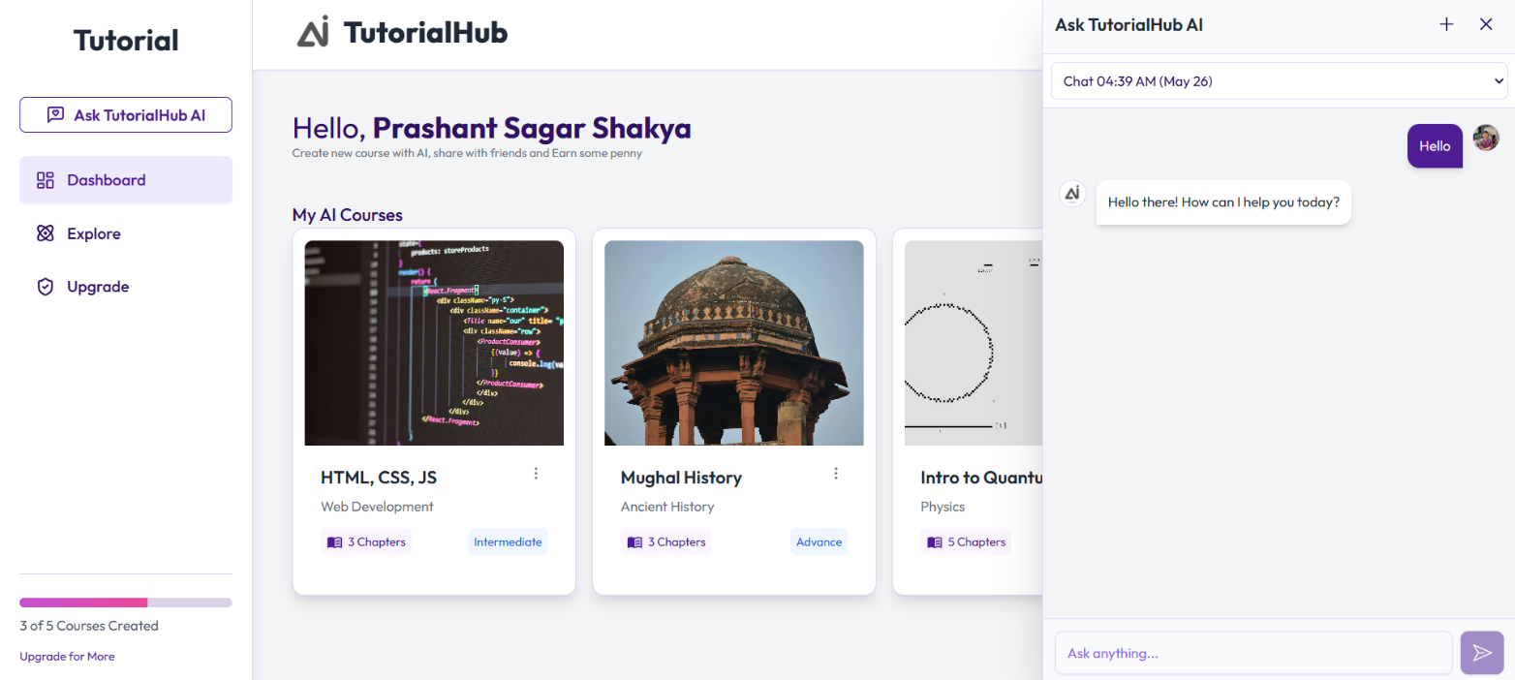
Step 2. User Dashboard with Gemini Chat Logic

Slide 21
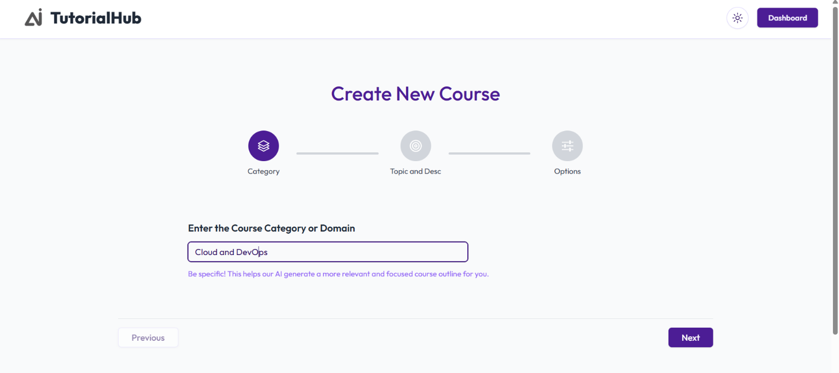
Step 3. Course Generation and Modification

Slide 22
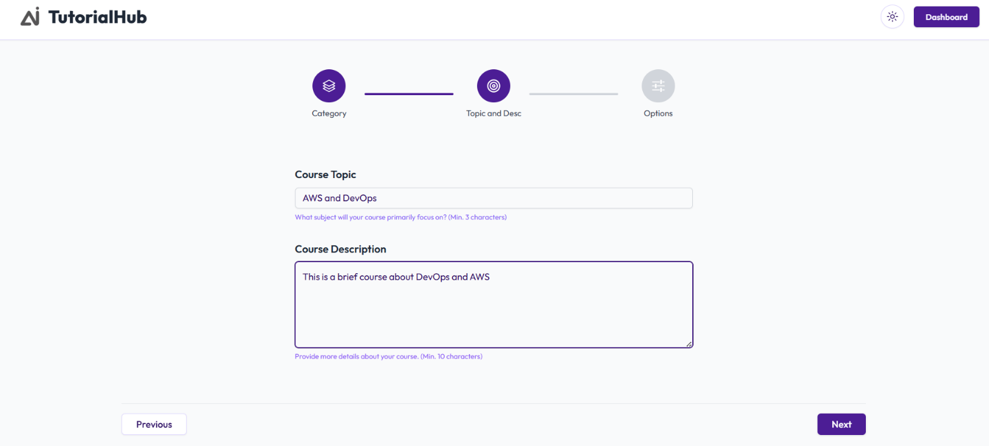

Slide 23
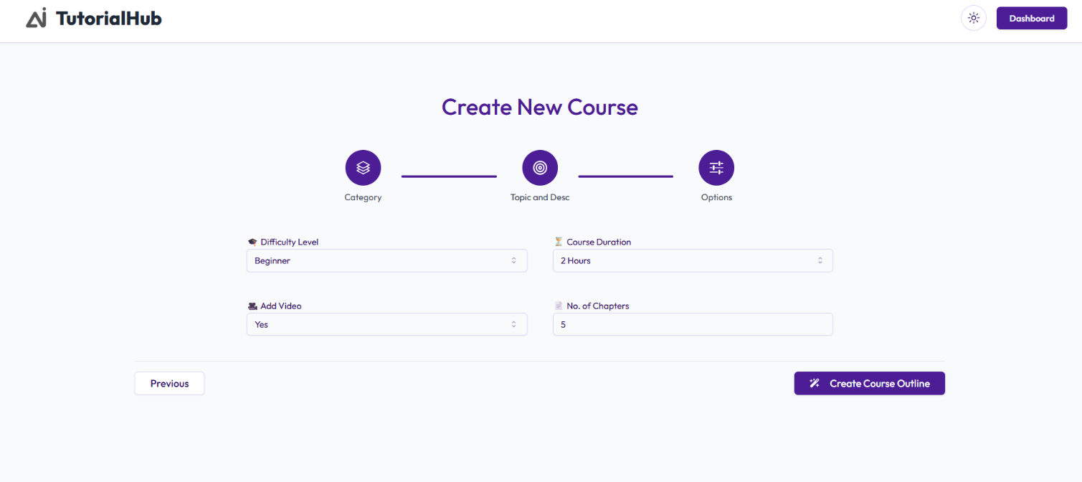

Slide 24
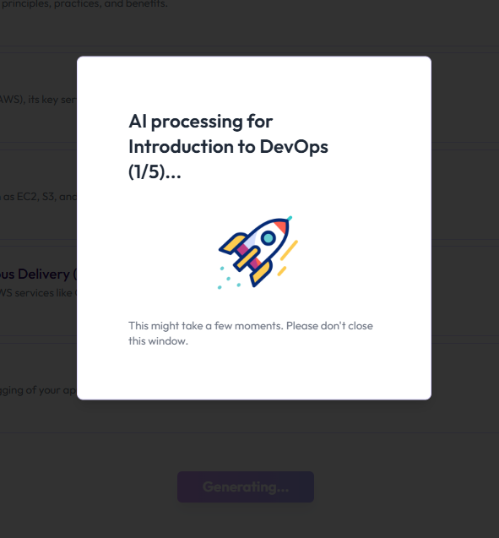

Slide 25
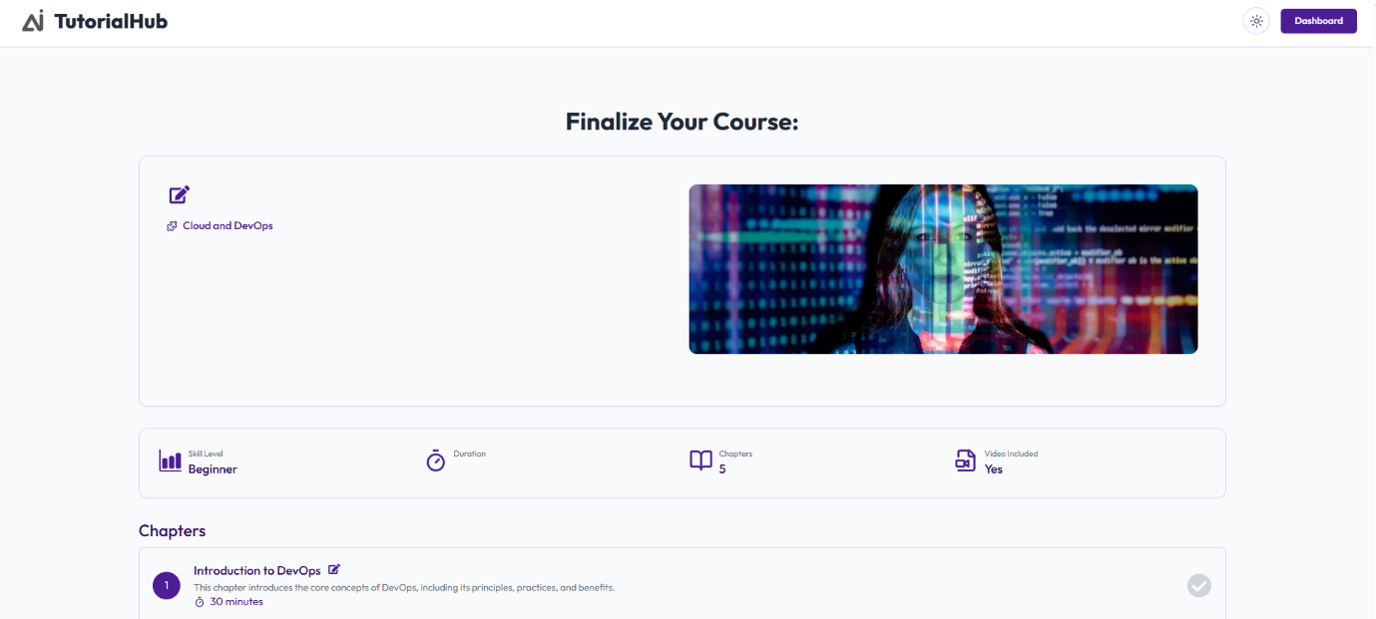

Slide 26
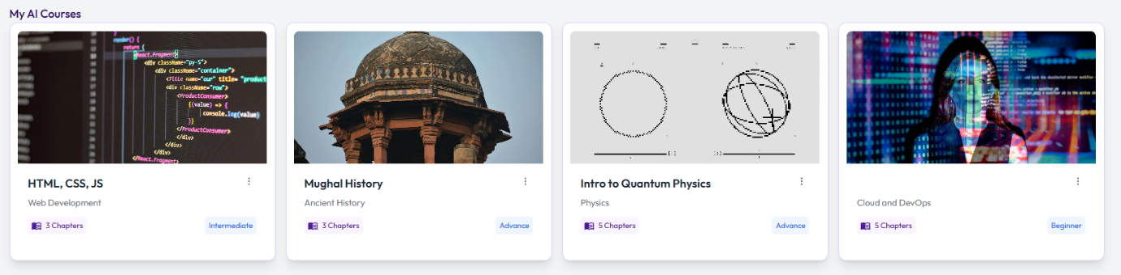

Slide 27
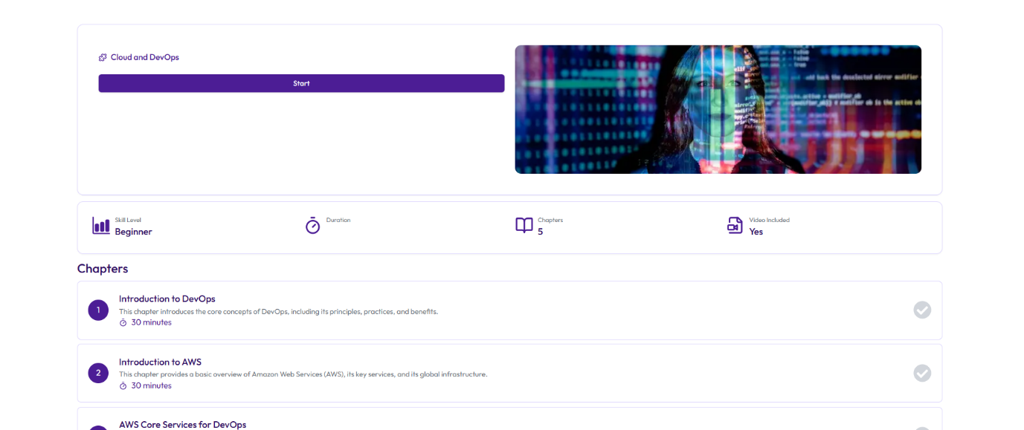
Step 4 Chapters and Quiz Logic

Slide 28
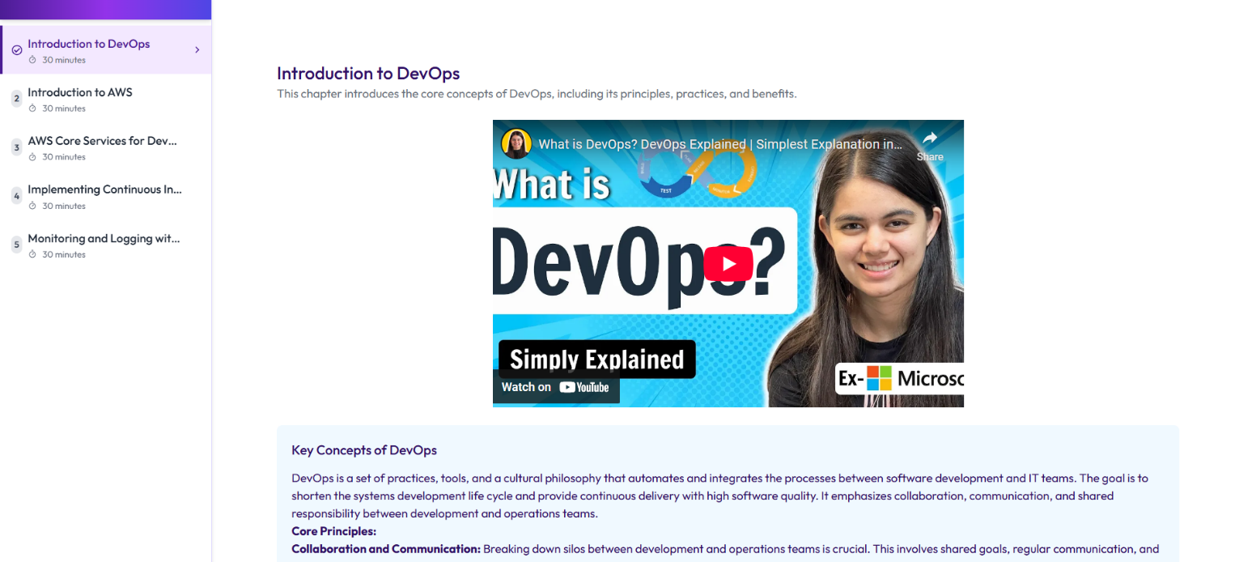

Slide 29
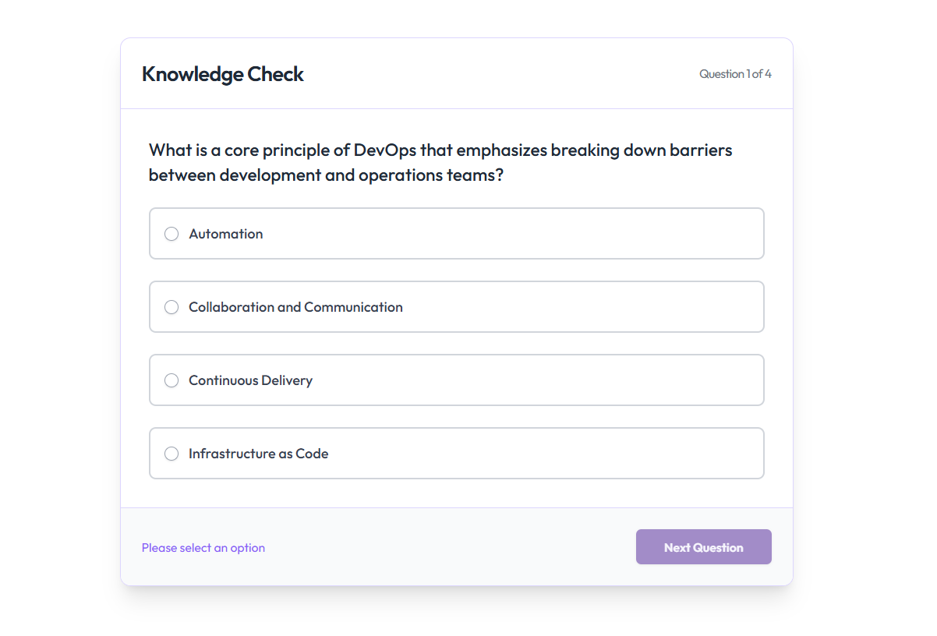
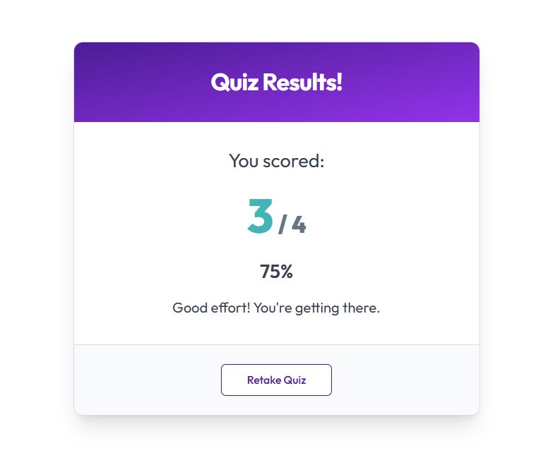

Slide 30
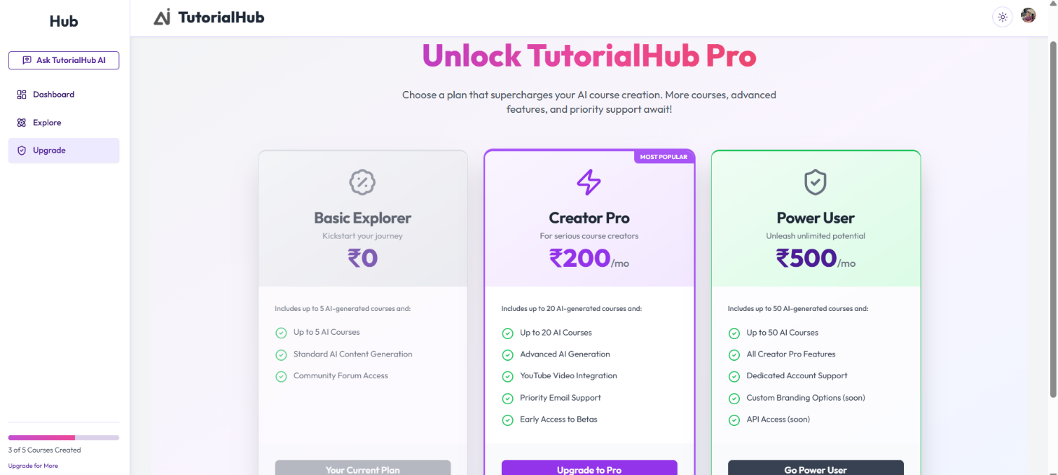
Step 5 Payment Plans

Slide 31

Conclusion
TutorialHub combines modern web technologies with generative AI to create a smart, scalable, and interactive platform for digital learning. With a focus on simplicity, customization, and automation, it empowers users to build and consume high-quality educational content with minimal effort. It stands as a future-ready solution in AI-based EdTech.

Slide 32
THANKS!
Does anyone have any question?

